Slide 1

Meet Taiwan
林品萱 Adelie 黃書欣 Susie
韋春妹 Ashley 王思薇 Amy
10/2
Group 5

Slide 2
Outline
Introduction of Meet Taiwan
The services of Meet Taiwan
The experience of the seniors
Conclusion

Slide 3

Website
Organized by the Bureau of Foreign Trade, Ministry of Economic Affairs of the Republic of China
Main purpose : Marking Taiwan to be the best location of holding trade conferences

Slide 4
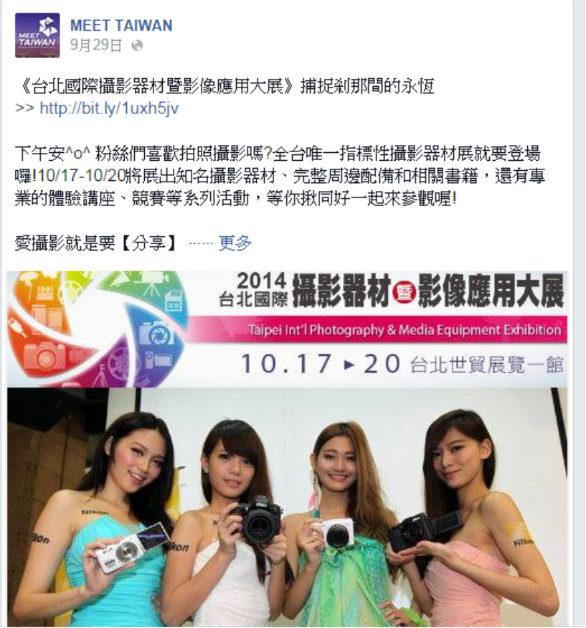
Ways of advertising
Facebook
Youtube

Slide 5
The Service of Meet Taiwan
Difference between Chinese and English version of the website
Chinese version- the plan for developing MICE indusrty
English version- promoting Taiwan as suitable cooperative partners

Slide 6
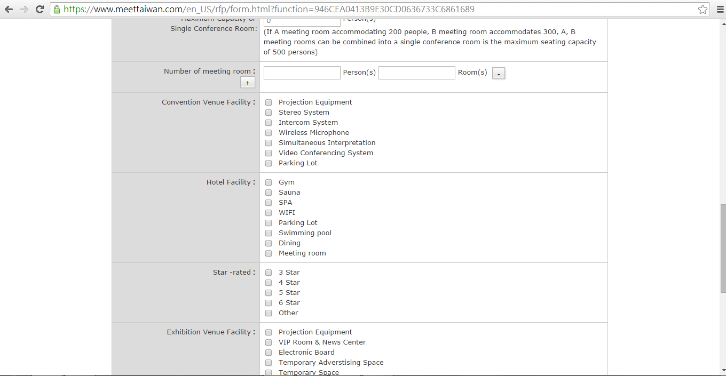
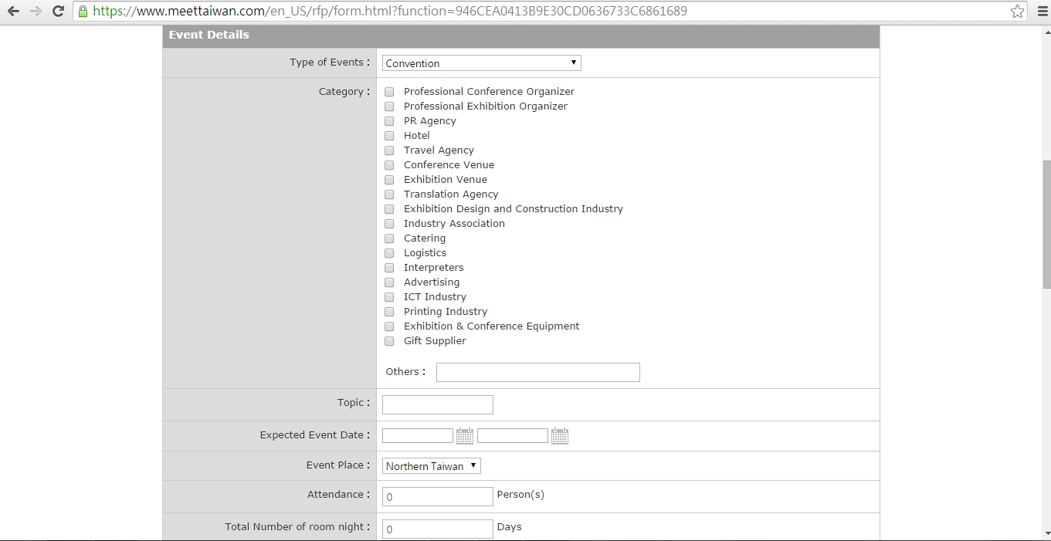
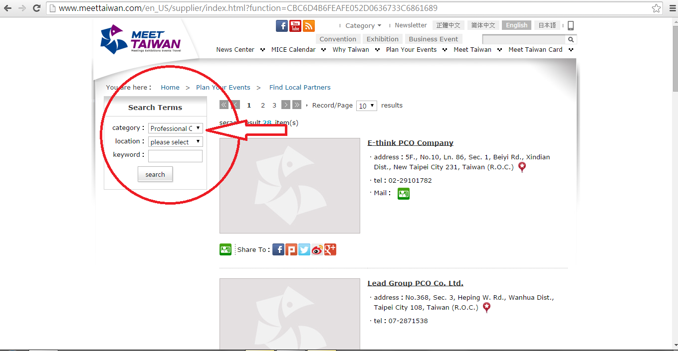
Providing information for organizers to find cooperative partners in Taiwan
Dealing with organizers' requests for proposal
The use of Taiwan Meet Card to enlarge MICE industry in Taiwan
Benifit of becoming the member of Meet Taiwan

Slide 7


Slide 8
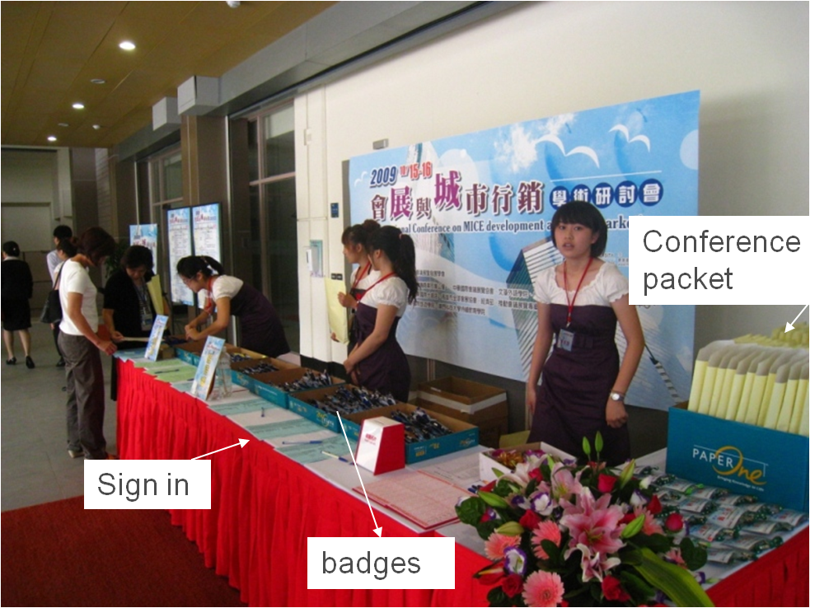
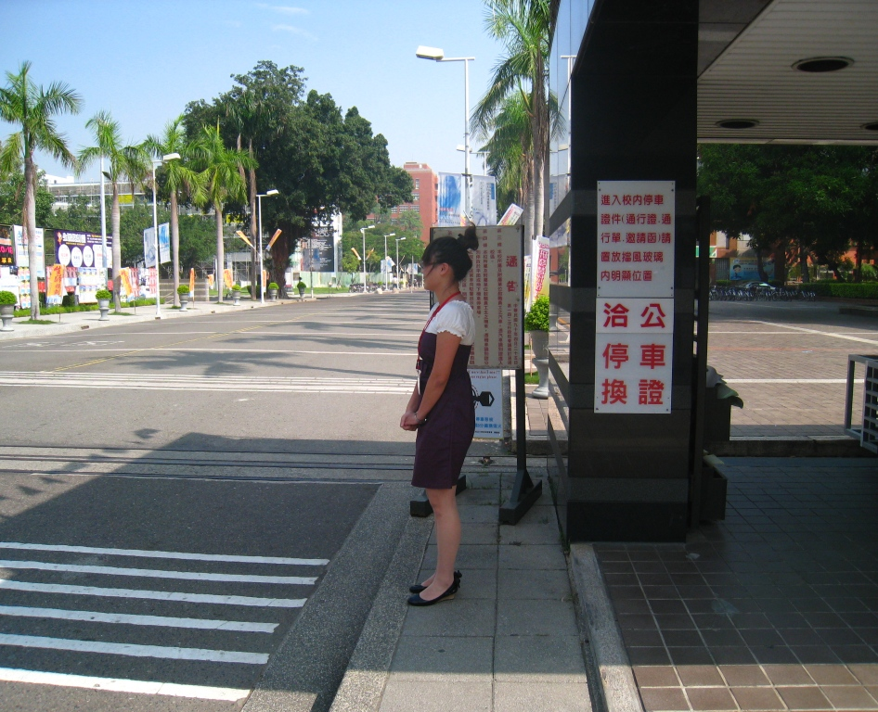
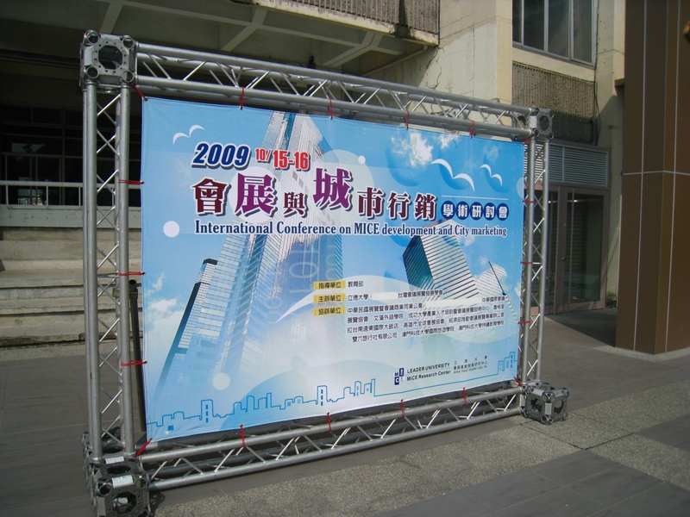
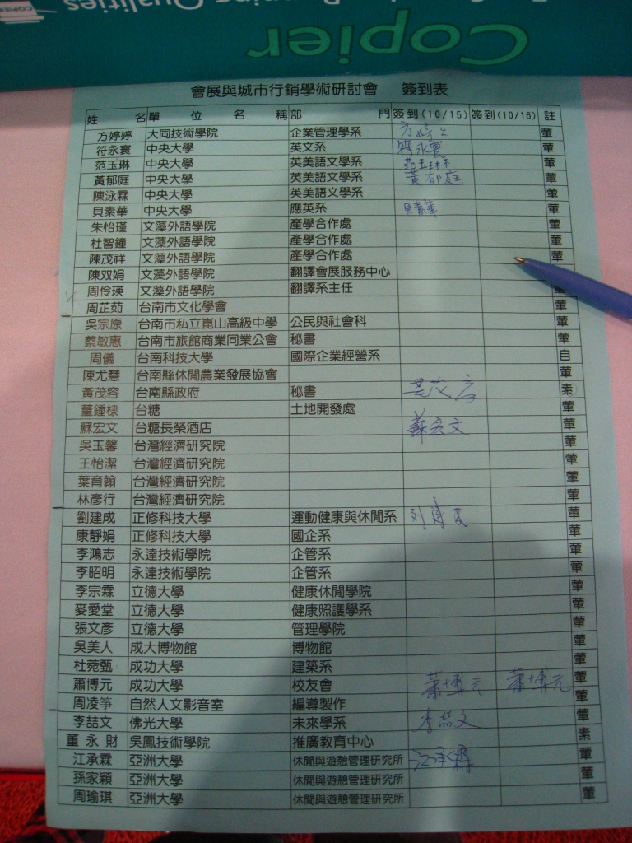
Before the conference
Clear traffic flow and smooth registration.

Slide 9
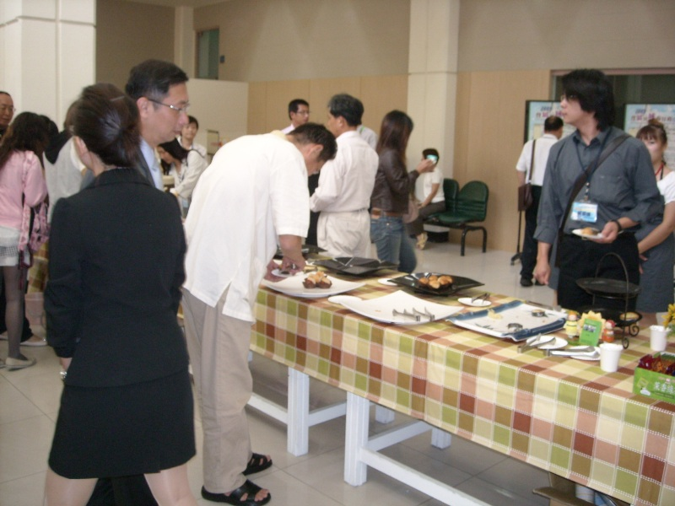
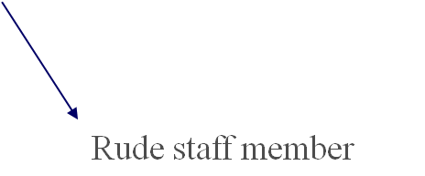
During the Conference
Poor time allotment, agenda planning and staff quality.

Slide 10

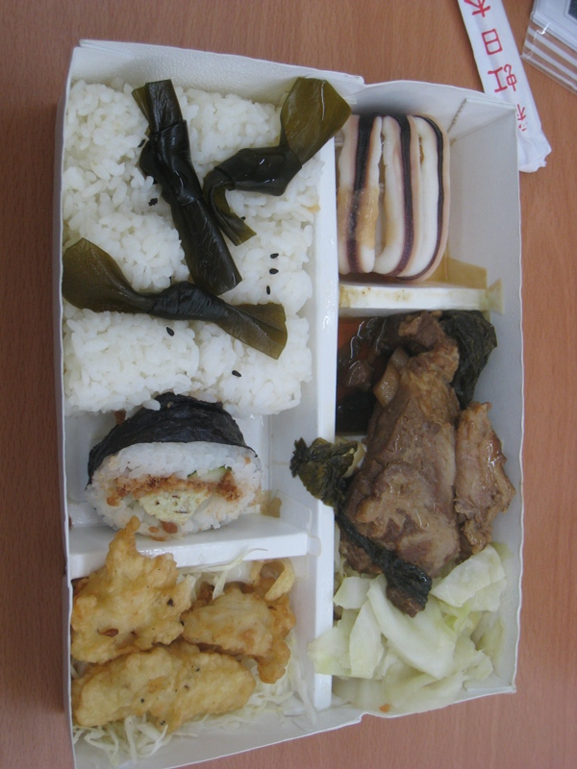
Others
Heavy program book, poor quality lunch, lots of technical problems, untidy bathroom……

Slide 11
Taiwan’s MICE Industry
Pilot Program
The program was launched to steer Taiwan’s MICE industry to shine on the global stage.
One of the objectives is to enhance the quality and efficiency of services.

Slide 12
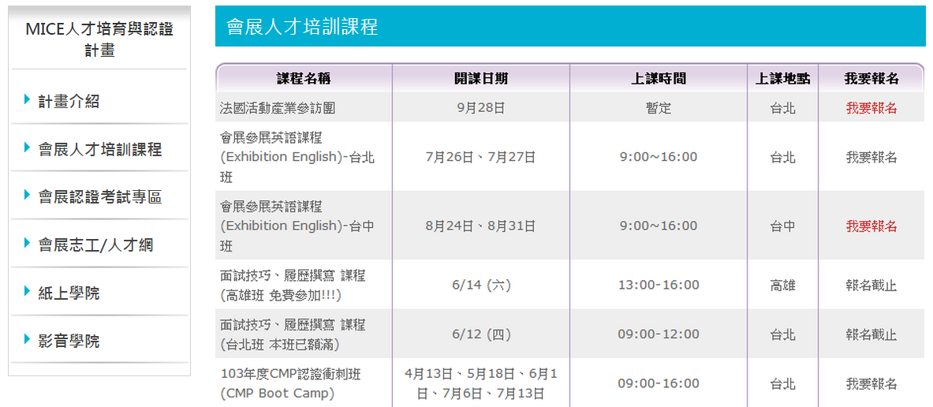
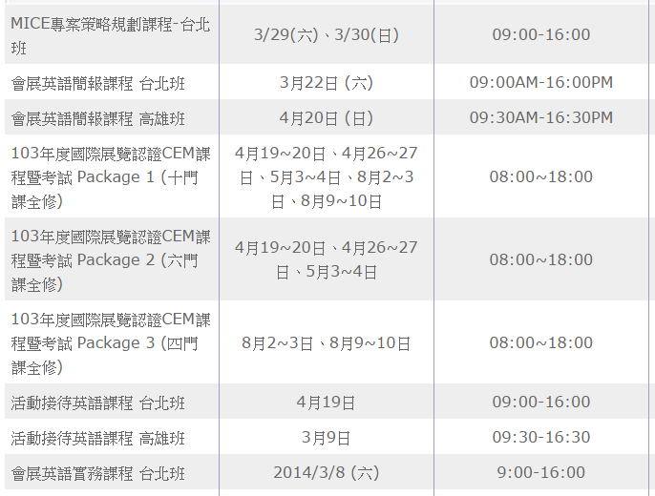
MICE Training and Certification Project
MICE Talent Development
Talent development courses:
offer courses aimed at developing professional MICE talent
MICE Talent Certification
Establish cooperation mechanisms with major international associations for talent certification.

Slide 13


